Slide 1

(CSCA-203)
Knowledge Representation & Reasoning
Lecture Week 6/1: Semantic Network
Farhad Muhammad Riaz
National University of Modern Languages

Slide 2
Semantic Networks
A Semantic Network (SN) is a simple notation scheme for logical knowledge representation.
A SN consists of a concepts and relations between concepts.
Representing a SN with a directed graph :
  Vertices : denote concepts.
  Edges : represent relation between concepts.
The graphical depiction associated with a SN is a significant reason for their popularity.

Slide 3
Semantic Networks
Consists of nodes and arcs.
Nodes represents objects.
Arcs represents relationships between the objects.
Relationships:
  is-a
  Instance
  has/has-a
  Others
.

Slide 4
Semantic Networks
Example (1)
“Bill is taller than John .”
  Non appropriate scheme :
Taller than
Bill
John
  Appropriate scheme :
Bill
John
height
height
Greater than
180
h₁
h₂
value

Slide 5
Semantic Networks
Relations
For an appropriate scheme:
  Draw relations on the basic of primitives.
  Represent complicated relations with this primitives.
Basic primitive
height
height
Taller than
Greater than
h₁
h₂

Slide 6
Semantic Networks
Relations
The ISA (is-a) relation is often used to link instances to classes, classes to superclasses.
Some links (e.g. isPart) are inherited along ISA paths.
The semantics of a SN can be relatively very formal or informal.
  often defined at the implementation level

Slide 7
Semantic Networks
Relations
furniture
is - a
isPart
Chairs
Seat
is - a
owner
color
Me
My chair
Tan
is - a
covering
is - a
Person
Leather
Brown

Slide 8
Semantic Networks
Relations
Some times we had to override a relation for an inherited node (e.g travel by).
Eagle
is - a
is - a
Birds
Animal
Panguin
is - a
Travel by
Travel by
Fly
Walk

Slide 9
Semantic Networks
Reification
Non-binary relationships can be represented by “turning the relationship into an object”
This is an example of what logicians call “reification”.
  consider an abstract concept to be real.
  We might want to represent the generic give event as a relation involving four things: an agent, a recipient, an object and an activation time.

Slide 10
Semantic Networks
Reification
Consider this : “John gave Mary the book.”
  Abstract concept (gave) => real.
Time
is - a
Past
Gave
Verb
Recipient
Object
Agent
Mary
John
The book

Slide 11
Semantic Networks
Example (2)
Family relationships.
Primitives :
  father, mother, brother, sister, son, daughter.
More complicated relations representing with primitives:
  aunt ( man ) : sister ( father ( man ))
  causion ( man ) : son ( brother ( mother ( man )))
  etc .

Slide 12
Semantic Networks
Example (3)
“Every dog has bitten a postman.”
Is equal to :
  ∀X ( dog(X) ∃Y ( postman(Y) & bitten(X, Y)))
Represent SN for one (dog, postman).
Quantify the represented SN.
GS is the set of generilized statements that has been quanified.

Slide 13
Semantic Networks
Example (3)
Dog
Bit
Postman
is - a
is - a
is - a
GS
Agent
Object
d
b
p
is - a
∀
g
Form

Slide 14
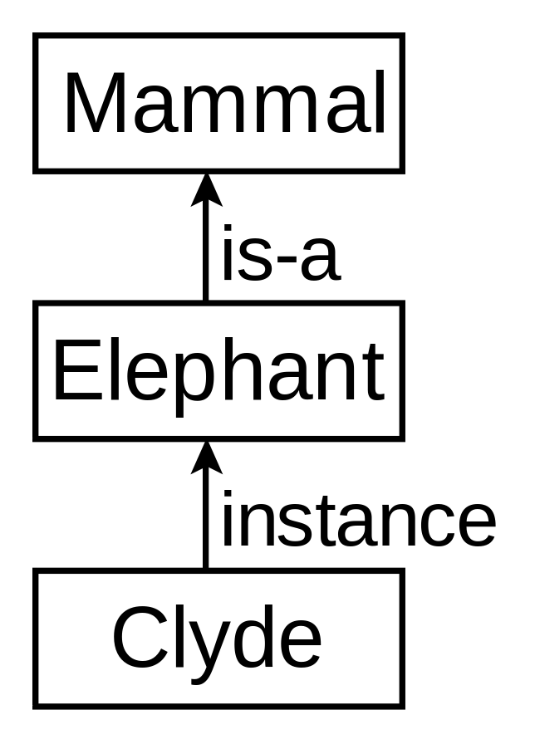
Example 4
Clyde is an elephant.
.

Slide 15
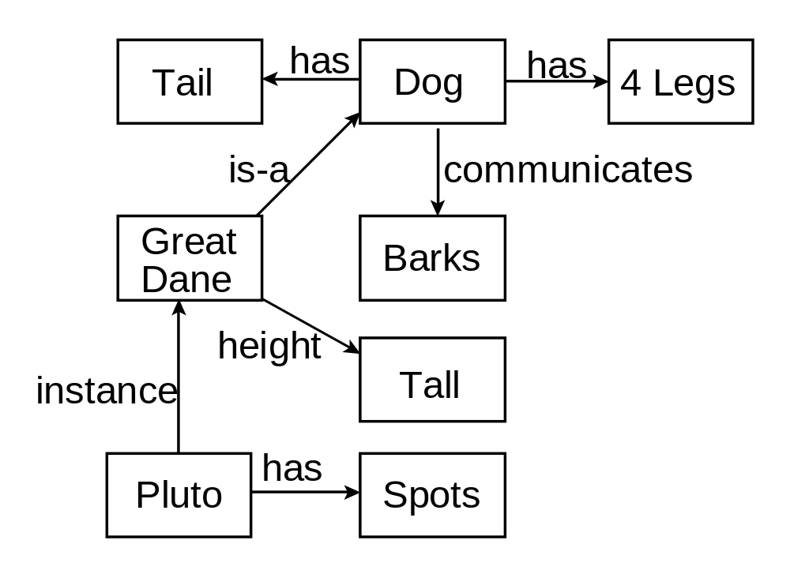
Example 5

Slide 16
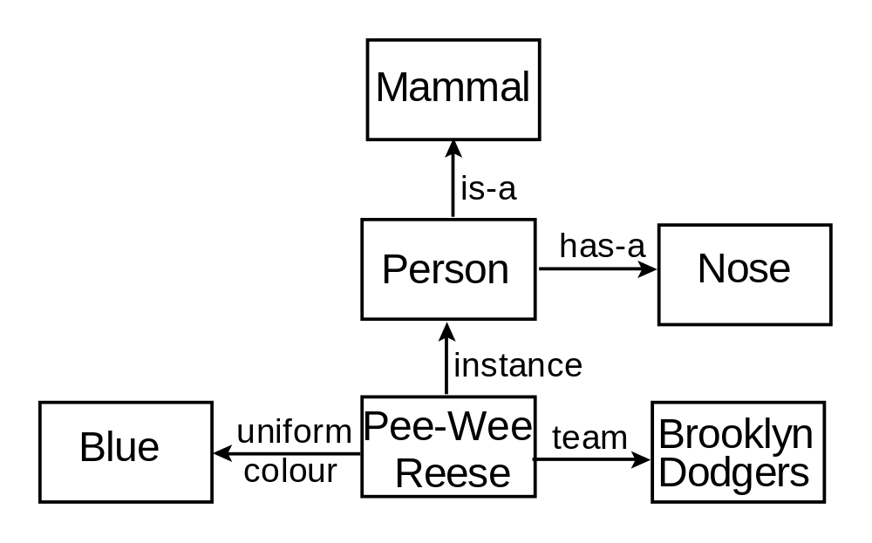
Example 6

Slide 17
Short Question
John’s height is 72.
John is taller than Bill.
John gives Mary the book.
Mary gave the green coloured vase to her favorite cousin.
Discrete StructuresDiscrete Structures

Slide 18
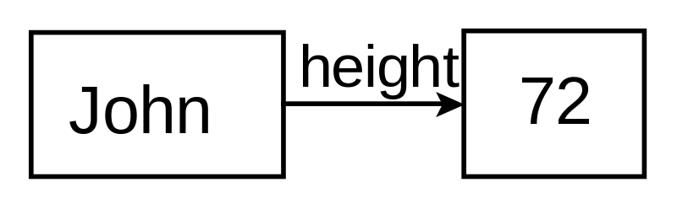
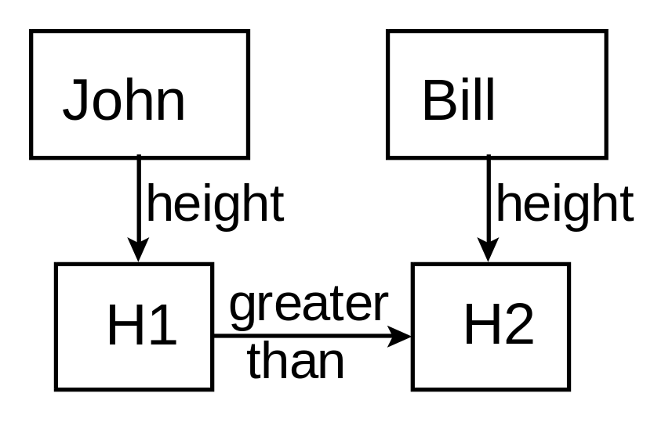
Example 7
John’s height is 72.
John is taller than Bill.

Slide 19
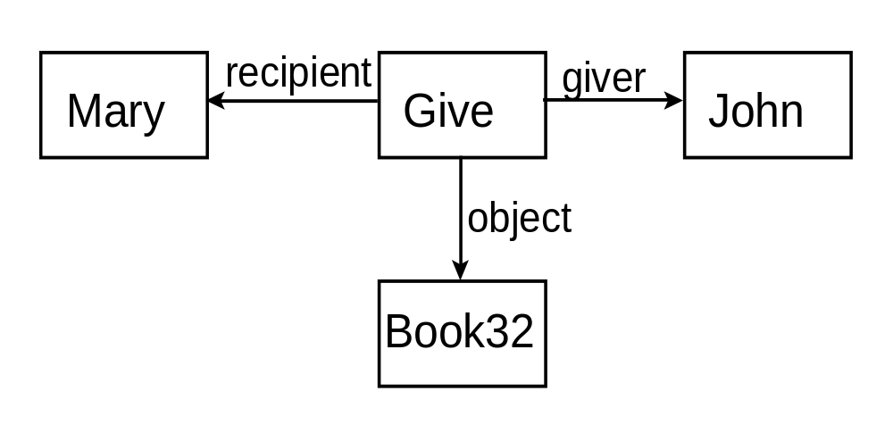
Example 8
John gives Mary the book.

Slide 20
Using Case Frames
Problems with semantic networks
Attempts to standardize semantic networks led to the development of case frames.
Each sentence is represented by a case frame.
Each case frame represents an actions.
Case frames define case relationships: agent, object, instrument, location and time.
.

Slide 21
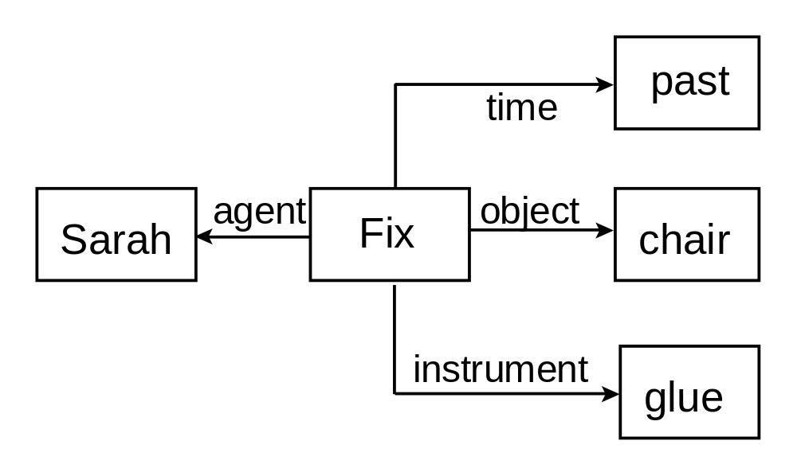
Example: Case Frame

Slide 22
Exercises
Construct semantic networks for the
following statements:
Pompeian(Marcus), Blacksmith(Marcus).
Mary gave the green coloured vase to her favorite cousin.
John went downtown to deposit his money in a bank.

Slide 23
Conceptual Graphs
Is a connected bipartite graph.
Conceptual relation nodes represent relations between concepts.
The arcs connecting nodes are not labeled.
Concepts are represented by boxes.
Relations are represented by arcs.

Slide 24
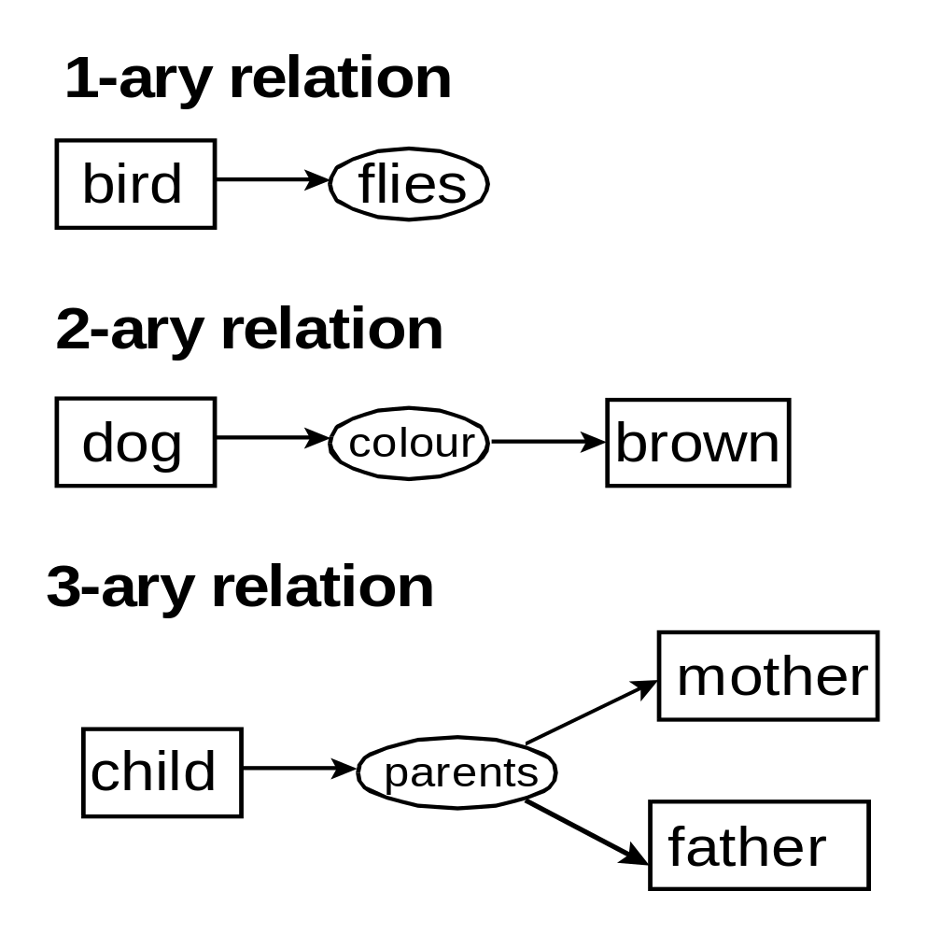
Conceptual Graph Relations

Slide 25
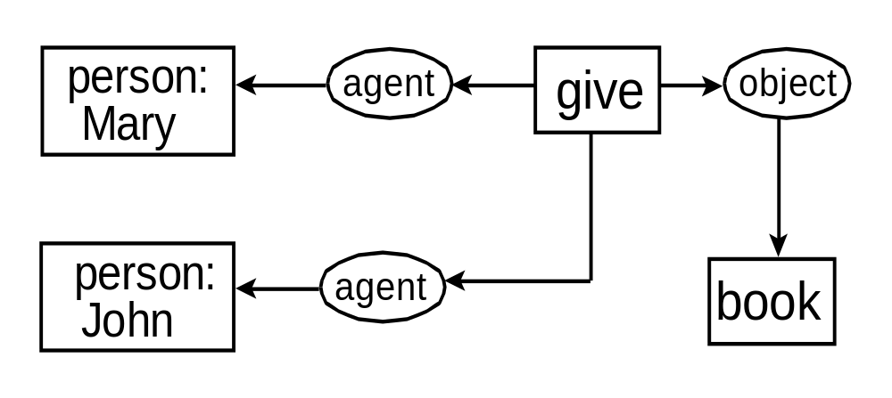
Example
Mary gave John the book.

Slide 26
Unique Markers
If an individual object is unknown a unique marker can be used in place of the name of the object.
A unique marker is comprised of a hash symbol (#) followed by a number.
Each object has its own unique marker.

Slide 27
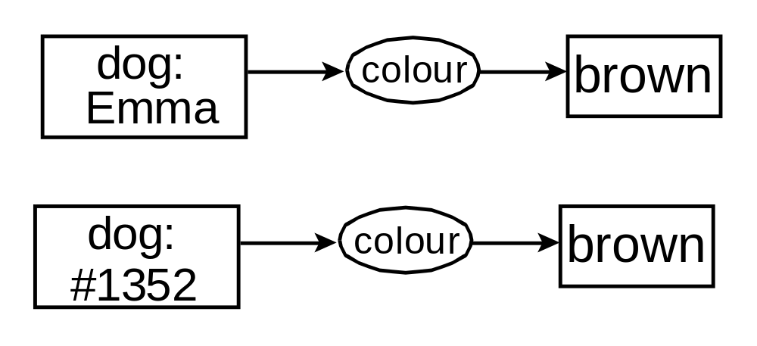
Example 1: Unique Markers

Slide 28
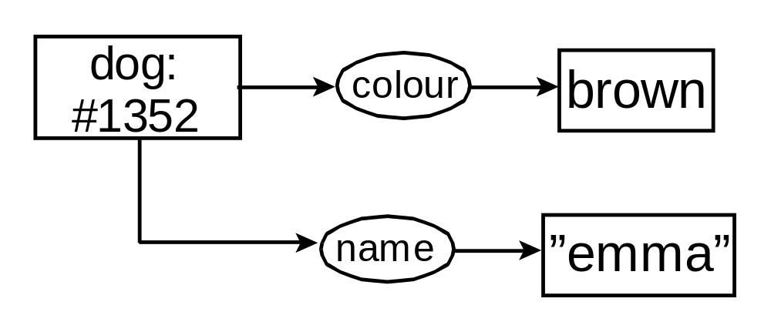
Example 2: Unique Marker

Slide 29
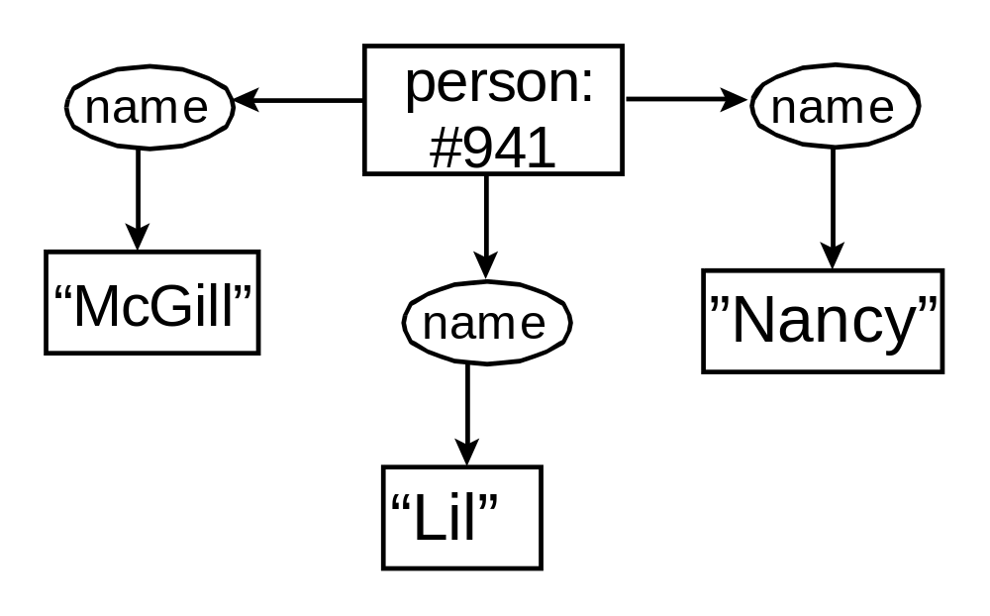
Example
Her name was McGill and she called herself Lil, but everyone knew her as Nancy.

Slide 30
Generic Markers
A generic marker is used to represent an unspecified individual of a type.
A generic marker is represented by an asterisk *.
Name variables can also be used, e.g., *X to indicate an unspecified individual.

Slide 31
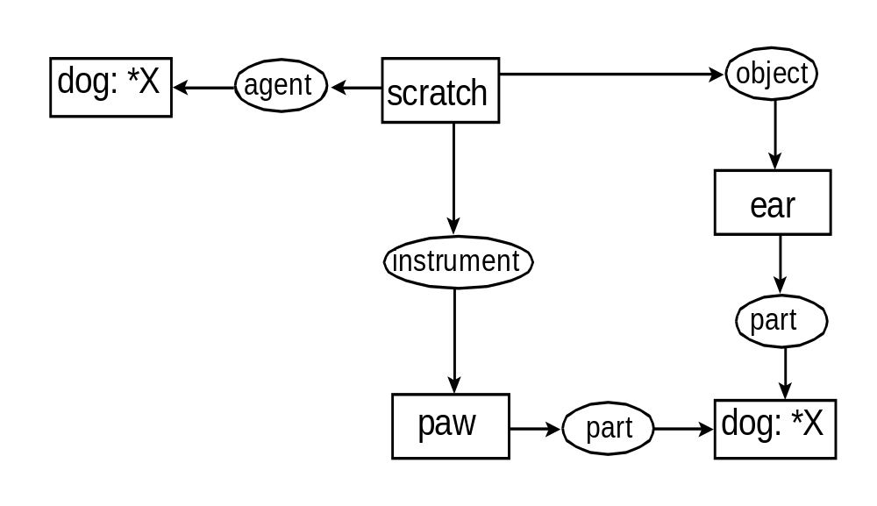
Example: Generic Marker
The dog is scratching its ear with its paw.

Slide 32
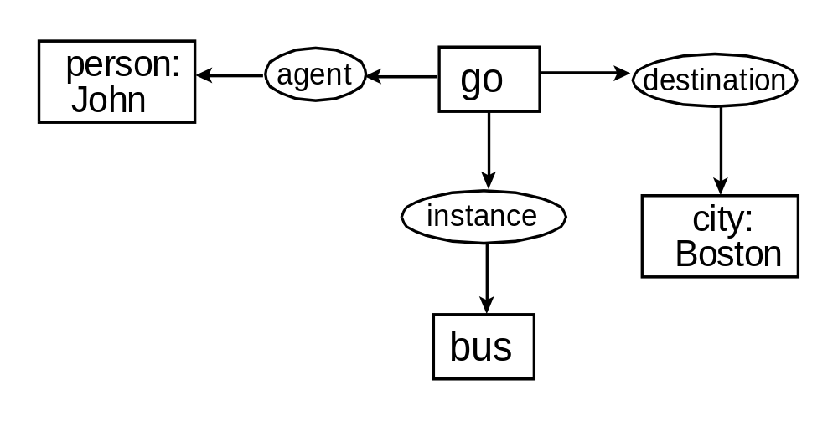
Display Form
John is going to Boston by bus.

Slide 33
Linear Form
John is going to Boston by bus.
[Go] –
(Agnt) → [Person: John]
(Dest) → [City: Boston]
(Inst) → [Bus]

Slide 34
Exercises
Construct conceptual graphs for the
following statements:
Jane gave Tom an ice cream.
Basketball players are tall.
Paul cut down the tree with an axe.
Place all the ingredients in a bowl and mix thoroughly.

Slide 35
?

